Slide 1
Flash Carma
by Adrian West, Brandon Sitz, Joseph Ramos-Garcia, and Josh Moore

Slide 2
Outline
What is Flash Carma?
Block Diagram
Data Model
Essential Technologies
Areas for Improvement
Questions
Live Demonstration

Slide 3
What is Flash Carma?
Traditional Flash Cards
Time consuming to create
Materials add unnecessary cost
Bland

Slide 4
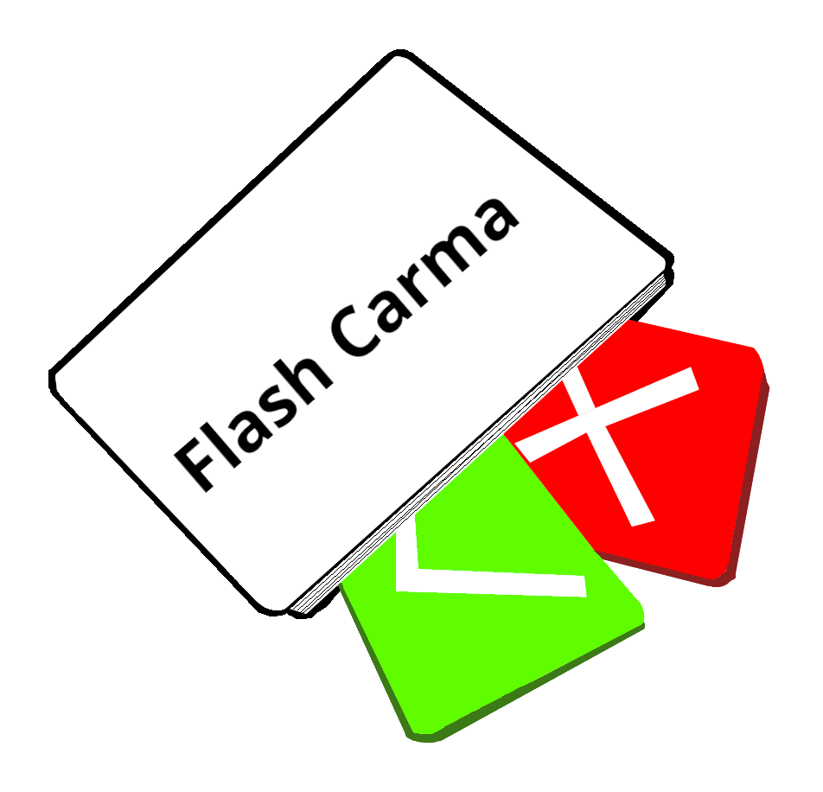
What is Flash Carma?
Flash Carma
Utilizes digital flashcards
No cost for additional cards
Entertaining features

Slide 5
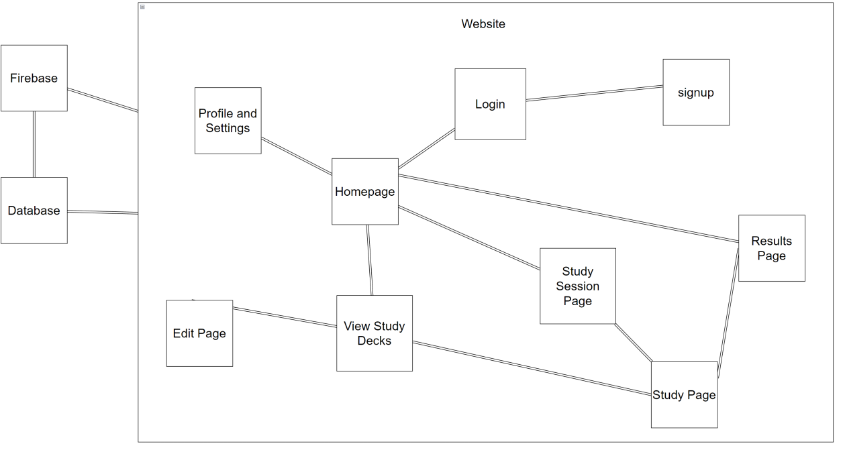
Block Diagram

Slide 6
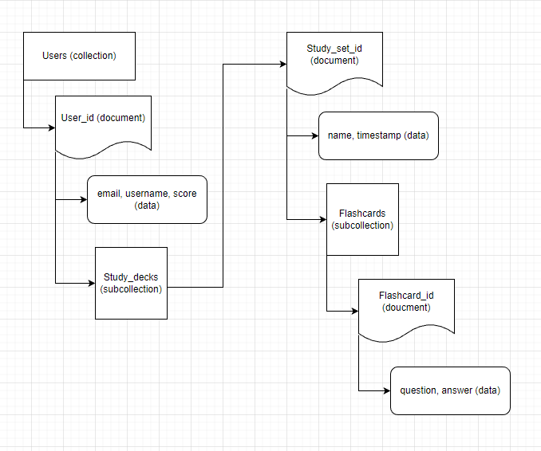
Data Model

Slide 7
Essential Technologies
Firebase
Chakra UI
React
Node JS

Slide 8
Areas for Improvement
White flash when loading certain pages
Animation for flashcards
Responsiveness
Overall UI maintenance and updating
Additional features (e.g., search bar, study recommendations)

Slide 9
Questions
Questions
Comments
Concerns
Without further ado, here is Flash Carma!

Slide 10
Live Demonstration
https://flash-carma.web.app/

